Slide 1
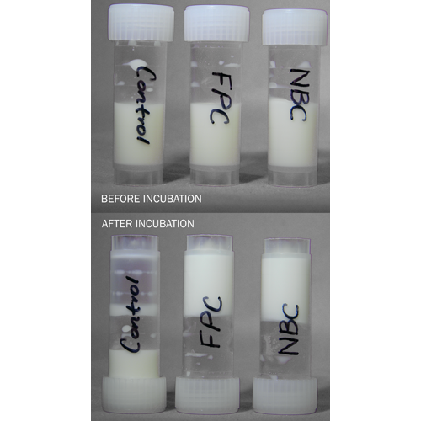
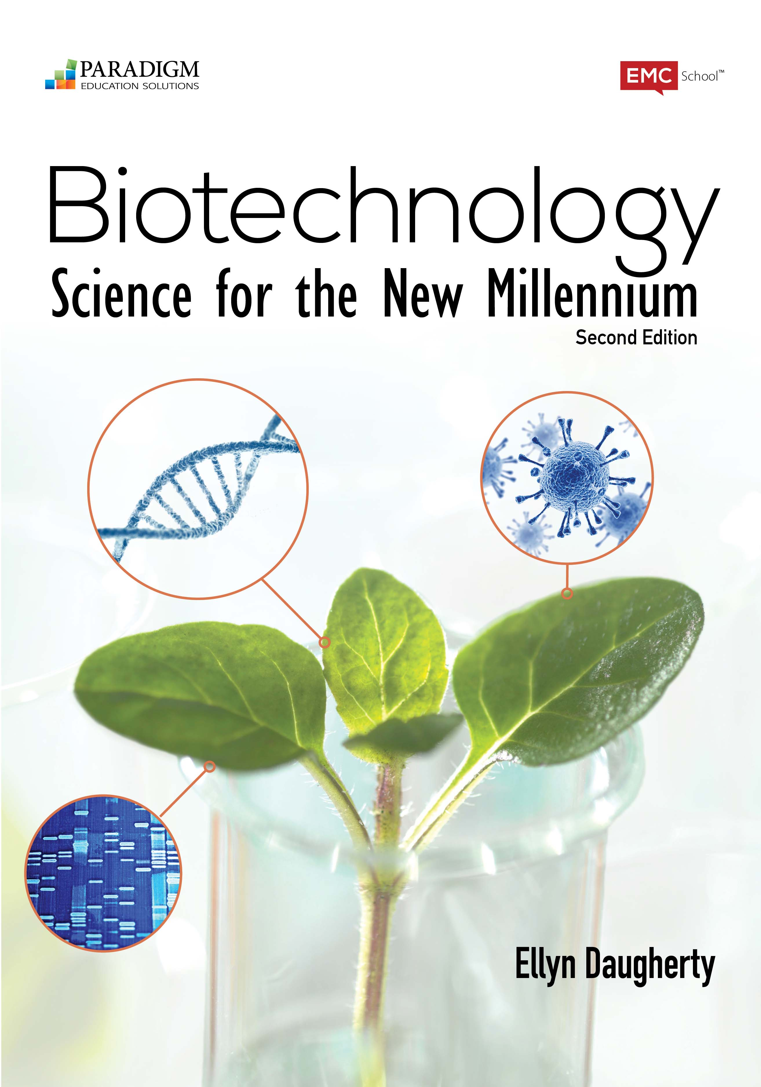
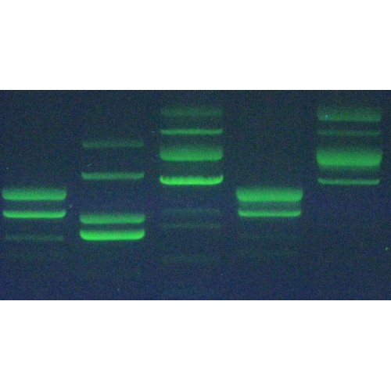
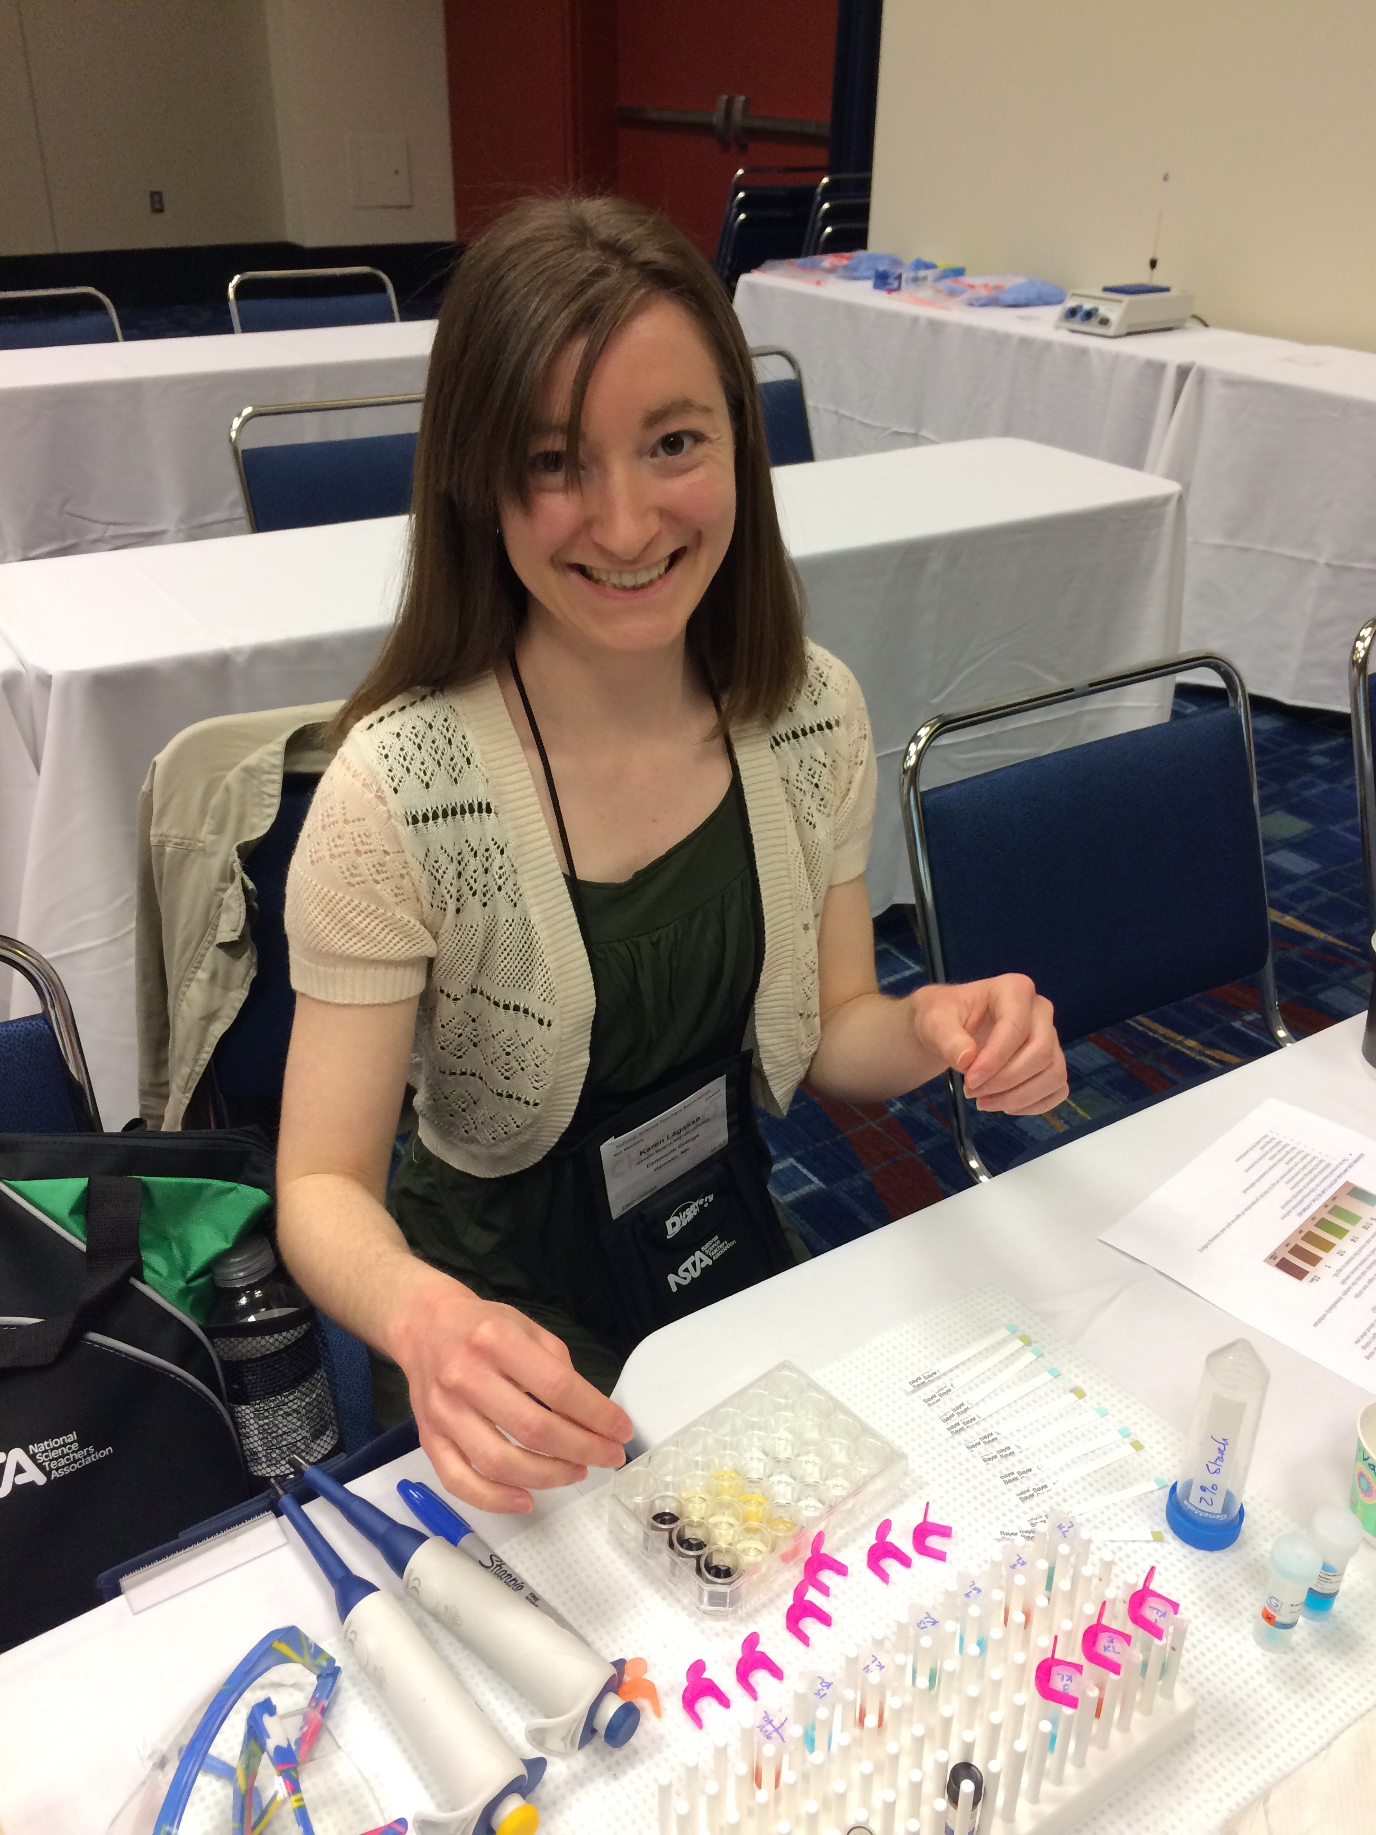
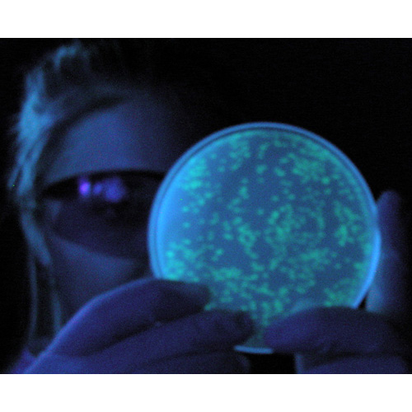
DNA is the Flash but
Proteins are the Cash of Biotech
Biotechnology: Science for the New Millennium
and
The rAmylase Project Kits
BS4NM 2E
Ellyn Daugherty
ellyn@BiotechEd.com
www.BiotechEd.com
G-Biosciences Kits
www.gbiosciences.com/BTNM

Slide 2
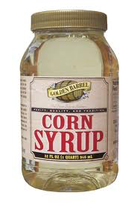
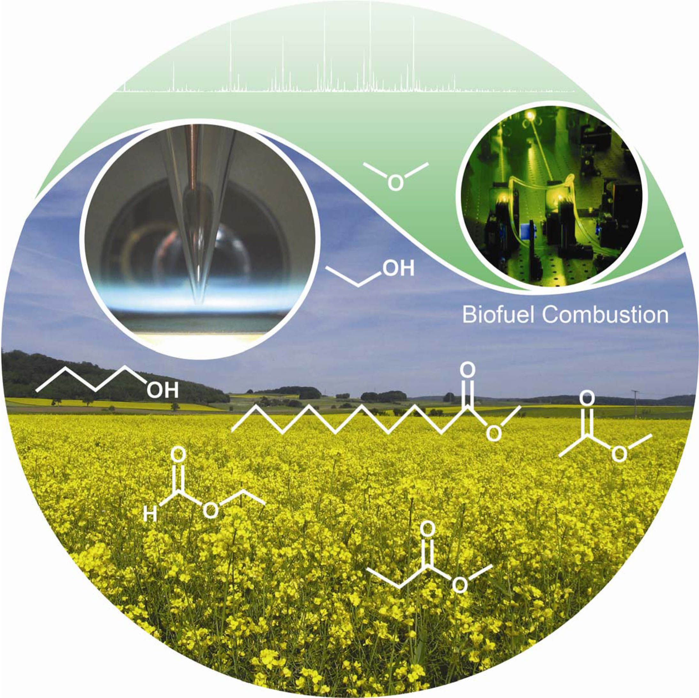
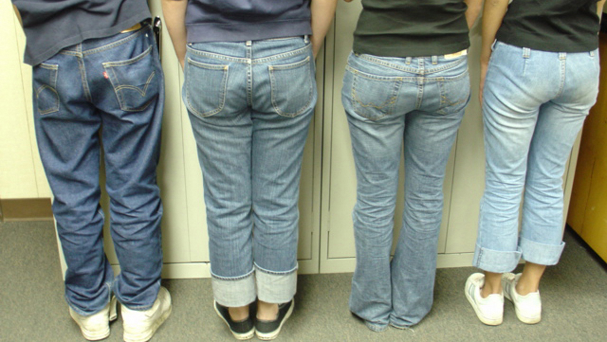
Amylase is a
commercially important biotech product
Amylase is an enzyme that catalyzes starch digestion to sugar. Used to:
Remove starch in products
Produce sugar from starch
Handle textiles
Process cellulostic biofuel

Slide 3
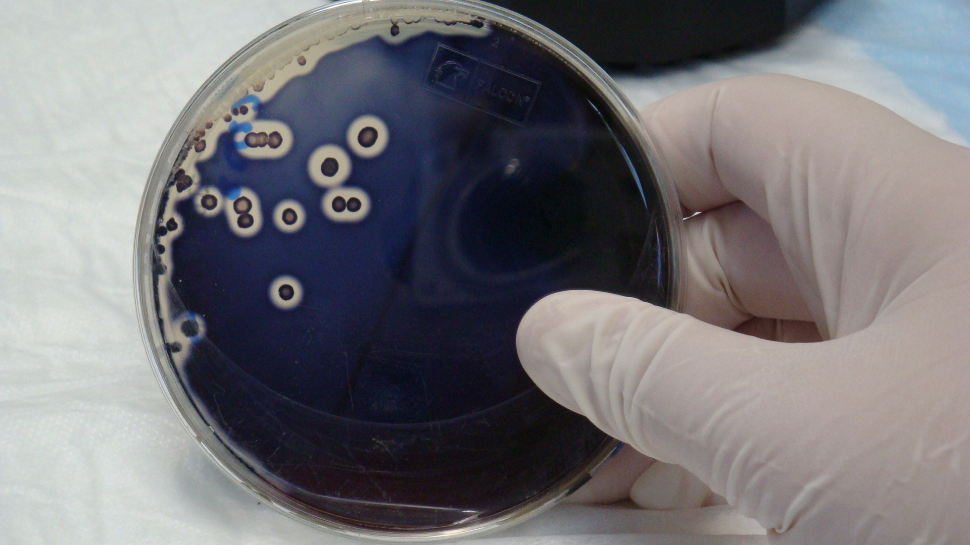
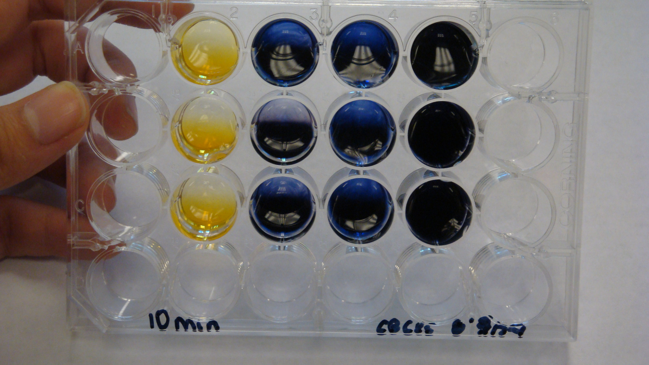
The goal of The rAmylase Project is to model the main steps in the identification and production of a genetically engineered product
Learn how to assay for amylase, a protein of commercial interest (rAmylase)
Genetically engineer cells to produce amylase (using pAmylase2014)
Grow transformed cells to volumes where amylase is purified and assayed

Slide 4
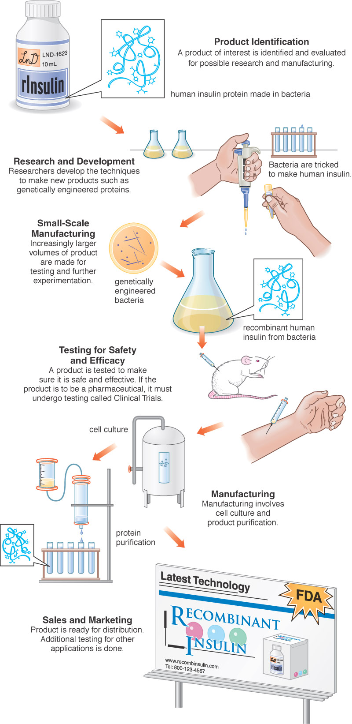
The rAmylase Project Curricular model of rDNA/protein Business using The rAmylase project Kits
Chapters 1-5 Basic SLOP
Lab 5f Characterizing Proteins by PAGE
Lab 6d Assaying for Amylase Activity
Lab 6e Direct ELISA of Bacterial Amylase
Lab 6f Western Blot to Identify Amylase
Lab 7d Amylase Concentration Assay
Lab 8b pAmy Plasmid Restriction Digestion
Lab 8c pAmylaseTransformation of E. coli
Lab 8g Miniprep for pAmylase Isolation
Lab 9c Amylase Ion-Ex Chromatography
Lab 13h Amylase Gene PCR
BS4NM Fig 1.21

Slide 5
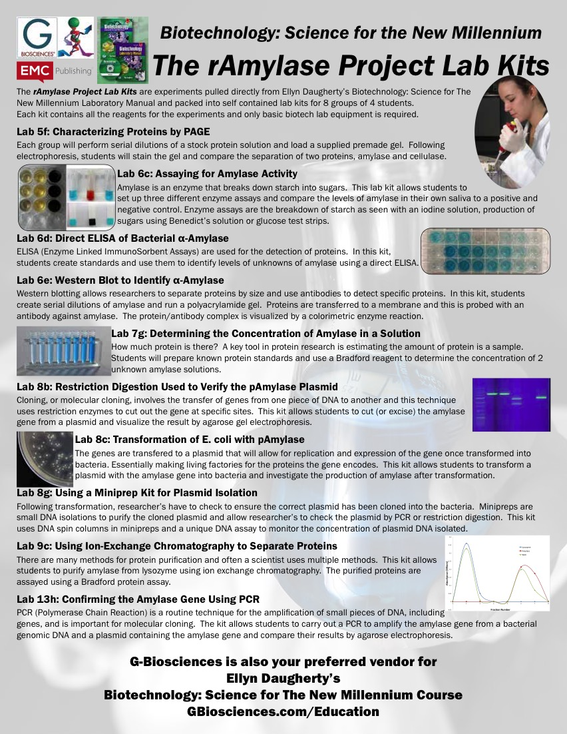

Slide 6
Biotechnology (The rAmylaseProject) Curricular Support
BiotechEd.com for PPTS, Syllabi, Activities, Hints, Links, etc.
www.gbiosciences.com/BTNM
For The rAmylase Project kits
www.FisherEdu.com/BS4NM
for entire BS4NM materials lists
Chapters 5-9 of B:S4NM Textbook & Lab Manual

